Slide 1



19CSE301 COMPUTER NETWORKS
3-0-3 4

Slide 2
Syllabus- 19CSE301 Computer Networks-3-0-3 4
Unit 1
The Internet-The Network Edge, the Network Core, Delay, Loss, and Throughput in Packet Switched Networks, Protocol Layers and Their Service Models. Principles of Network Applications: The Web and HTTP, File Trans- fer: FTP, Electronic Mail in the Internet, DNS - The Internet’s Directory Service, Peer-to-Peer Applications. Introduction and Transport Layer Services: Multiplexing and Demultiplexing, Connectionless Transport - UDP, Principles of Reliable Data Transfer.
Unit 2
Transport layer - Connection Oriented Transport - TCP, Principles of Congestion Control, TCP Congestion Control. Introduction Network Layer: Virtual Circuit and Datagram Networks, Inside a Router, The Inter- net Protocol (IP) - Forwarding and Addressing in the Internet, Routing Algorithms, Routing in the Internet, Broadcast and Multicast Routing.
Unit 3
The Link Layer and Local Area Networks - Introduction and Services, Error-Detection and Correction Tech- niques, Multiple Access Protocols, Link-Layer Addressing, Ethernet, Link-Layer Switches, Case study – Virtualization and Data center networking.
Text Books
1. Kurose J F and Ross K W, “Computer Networking: A Top-Down Approach”, Sixth Edition, Pearson Press, 2013.
References
Tanenbaum A S, “Computer Networks”, Third Edition, PHI, 2004.
Stallings W, “Data and Computer Communications”, Seventh Edition, Pearson Education Asia, 2004.

Slide 3
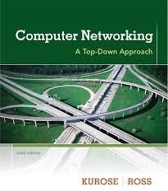

Slide 4
Chapters
Chapter 1 Computer Networks and the Internet
Chapter 2 Application Layer
Chapter 3 Transport Layer
Chapter 4 The Network Layer
Chapter 5 The Link Layer and LANs

Slide 5
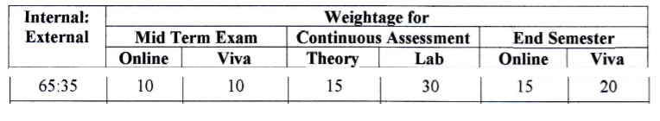
Evaluation Pattern
Computer Networks Theory
Assignment (one) - 10 marks
Paper/Topic presentation video upload - 5 marks
Computer Networks Lab
Lab Evaluation I (Wireshark) - (10 marks)
Lab Evaluation II (Socket Programming) - (10 marks)
Lab Evaluation III (Packet Tracer) - (10 marks)

Slide 6

Chapter I:
Computer Networks and the Internet

Slide 7
Chapter -1 Introduction
1.1 What Is the Internet?
1.1.3 What Is a Protocol?
1.2 The Network Edge
1.2.1 Access Networks
1.2.2 Physical Media
1.3 The Network Core
1.3.1 Packet Switching
1.3.2 Circuit Switching
1.3.3 A Network of Networks
1.4 Delay, Loss, and Throughput in Packet-Switched Networks
1.5 Protocol Layers and Their Service Models
1.5.1 Layered Architecture
1.5.2 Encapsulation

Slide 8
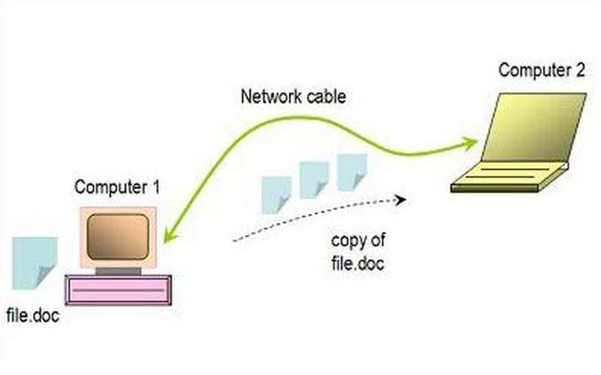
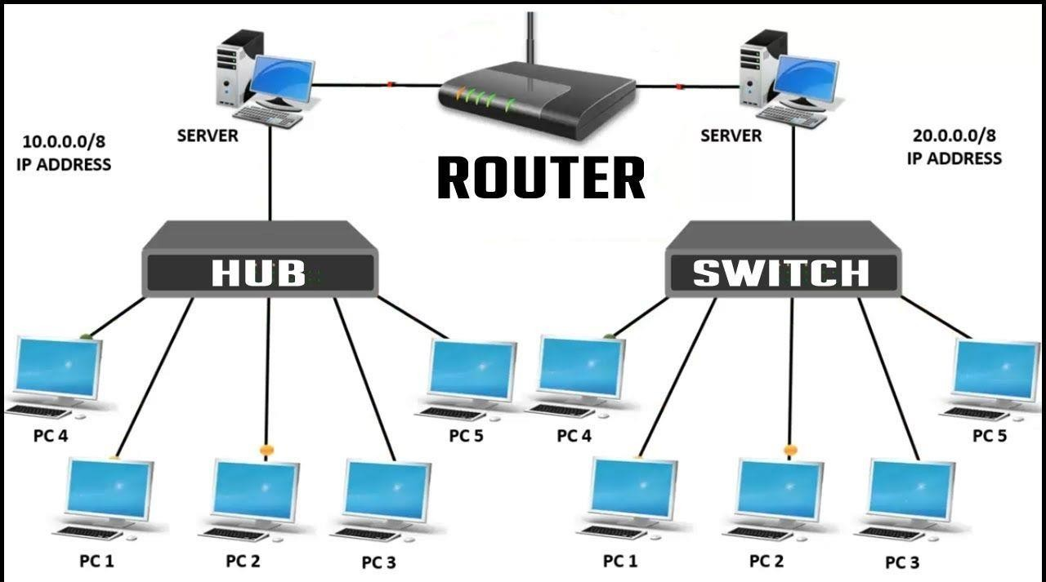
What is a computer Network
A computer network is a set of computers that are connected together so that they can share information .Computer networks are the basis of communication in IT. They are used in a huge variety of ways and can include many different types of network..
Some of the things that networks are used for include:
Communicating using email, video, instant messaging and other methods
Sharing devices such as printers, scanners and photocopiers
Sharing files
Sharing software and operating programs on remote systems
Allowing network users to easily access and maintain information

Slide 9
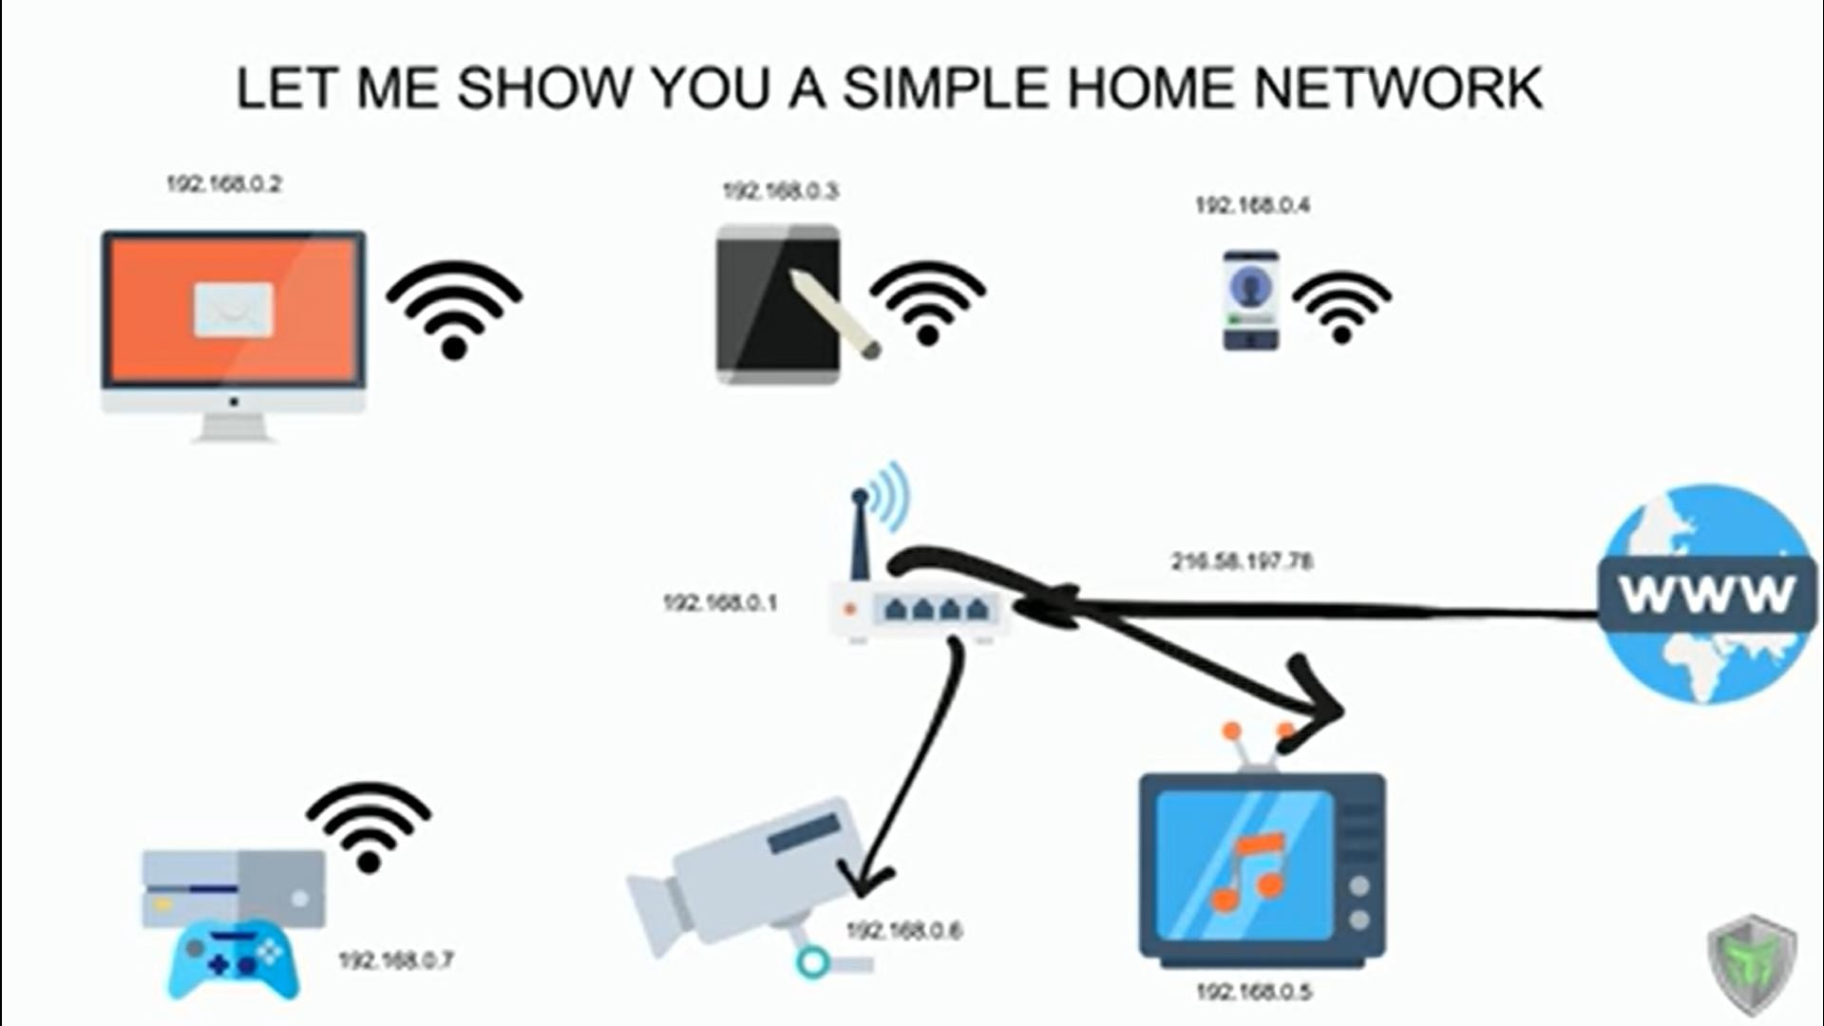

Slide 10


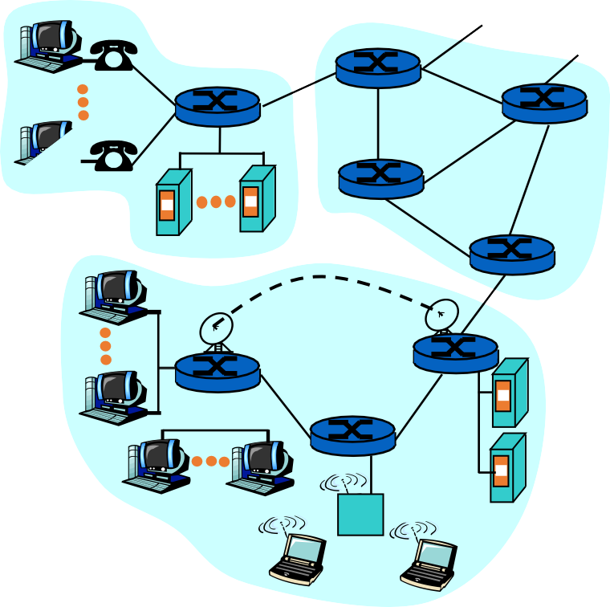
What is a Computer Network?
A set of communication elements connected by communication links
➭ Communication elements
Computers, printers, mobile phones, …
Routers, switches, ...
➭ Communication links
optic fiber
coaxial cable
twisted pair
wireless (radio, microwave, satellite)
router
workstation
mobile
server
local ISP
regional ISP
➭ Topologies
Ring, Star, Bus, Tree, Mesh
company network

Slide 11

Introduction
Computer Network
an interconnected collection of autonomous computers
Internet: “network of networks”
loosely hierarchical
public Internet versus private Intranet
WWW a distributed systems run on the top of Internet
Distributed System
High degree of cohesiveness and transparency
A software system built on top of a network
11

Slide 12
Internetworks
Internetworks connect networks with different hardware and software
A collection of interconnected networks is called an internetwork or internet
Gateways are used to make the connection and to provide the necessary translation (protocol conversion)
A gateway is a node (router) in a computer network, a key stopping point for data on its way to or from other networks.
... For basic Internet connections at home, the gateway is the Internet Service Provider that gives you access to the
entire Internet.
12

Slide 13
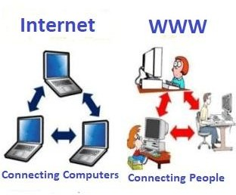
Internet : WWW
World Wide Web, ( Web), is a large distributed system, a collection of websites or web pages stored in web servers and connected to local computers through the internet.
Internet is the network of connected computers that the web works on, as well as what emails and files travel across.
Think of the internet as the roads that connect towns and cities together. The world wide web contains the things you see on
the roads like houses and shops

Slide 14
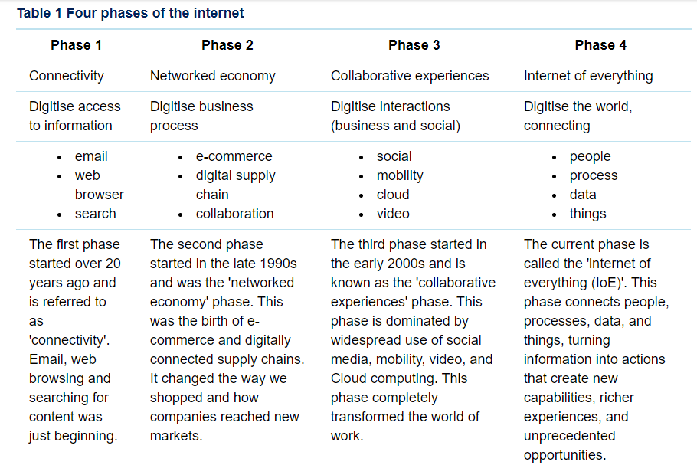
Evolution of Internet

Slide 15
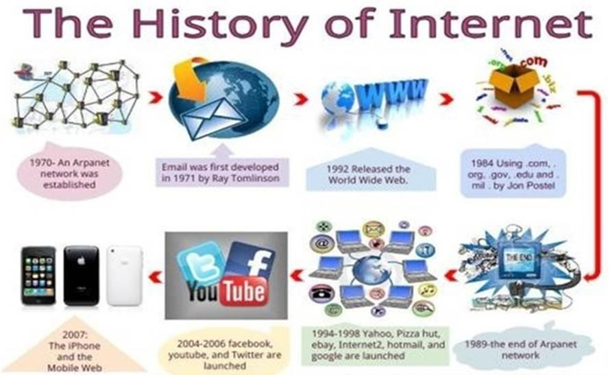
History of Internet
The first workable prototype of
the Internet came in the late 1960s with the creation of ARPANET, or the Advanced Research Projects Agency Network.
Originally funded by the U.S. Department of Defense, ARPANET used packet switching to allow multiple computers to communicate on a single network.

Slide 16


































Internet – its component
mobile network
Multiple ISPs together form
the Internet
Global, regional ISPs, residential ISPs, home network, enterprise network
Hosts, servers, Network core, switches, routers
global ISP
home
network
regional ISP
institutional
network
J. Kurose and K. Ross 2012, Computer Network,6th ed.

Slide 17




















Internet – its component
protocols control sending, receiving of msgs
e.g., TCP, IP, HTTP,
Skype, 802.11
Internet standards
RFC: Request for comments
IETF: Internet Engineering Task Force
mobile network
global ISP
home
network
regional ISP
Physical media
Copper wire, optical
fiber,
institutional
network
The IETF is a large open international community of network designers, operators, vendors, and researcher who make the Internet
work better by producing high quality, relevant technical documents that influence the way people design, use, and manage the Internet.

Slide 18





